Slide 1
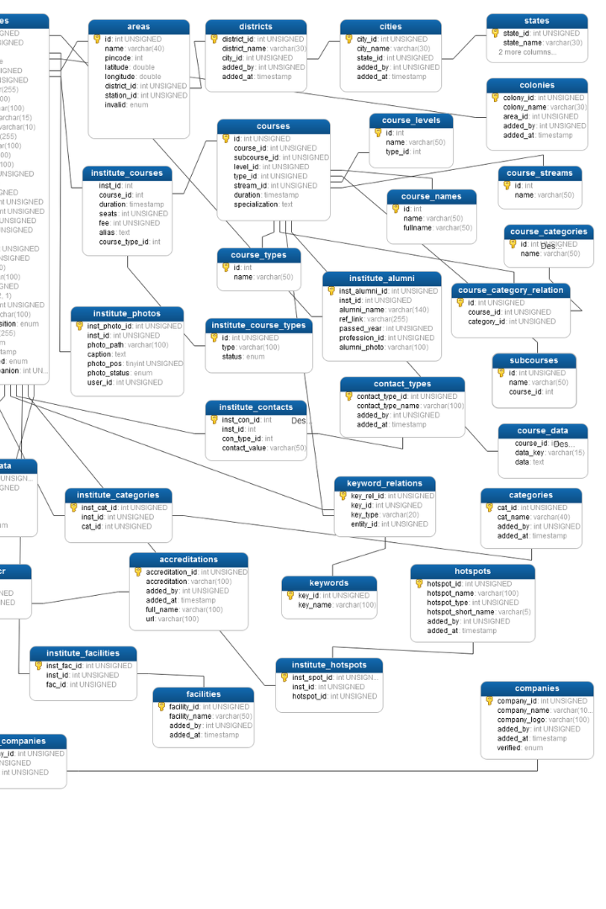
Certified Java Full Stack Professional - Capgemini College Connect
Introduction to Datatypes in MySQL
In MySQL, datatypes are used to represent:
The nature of the data that can be stored in a database
Possible values for that type,
Operations that can be performed on that type
Stored values of that type
Efficient handling of data
- Bhakti Menkar
Batch:2023-10427
Enrollment No: EBEON0923756263

Slide 2
Data Types
1
Numeric Data Type
4
Binary Large Object Data Types (BLOB)
Exact numeric data types
For example, integer, decimal, numeric, etc.
Hold a variable amount of data
Categories into four different types
2
Date and Time
5
Spatial Data Type
Temporal values such as date, time, datetime, timestamp, and year
Hold various geometrical and geographical values
3
String Type
6
JSON Data Type
Hold plain text and binary data
For example, files, images, etc.
Added from version v5.7.8
Allows to store and access the JSON document

Slide 3
Characteristics Used to Determine the Data Type
1
Storage Size
2
Data Range
The amount of space the data type occupies in the database
The range of values that the data type can hold
3
Data Comparison
4
Indexing
How MySQL performs a comparison of values of a particular data type.
Ability to be efficiently indexed for faster retrieval

Slide 4
Numeric Datatypes
Signed or Unsigned Types
Signed Types
TINYINT INT | very small integer up to 4 digits Takes 1 byte for storage.
SMALLINT | Small integer up to 5 digits Takes 2 byte for storage.
MEDIUMINT | Medium integer up to 9 digits Takes 3 byte for storage.
INT | Normal integer up to 11 digits Takes 4 byte for storage.
BIGINT | Large integer up to 20 digits Takes 5 byte for storage.
FLOAT (m,d) | display length (m) number of decimals (d) Default 10,2 2 bytes
DOUBLE (m,d) | display length (m) number of decimals (d) Default 10,2 8 bytes
DECIMAL (m,d) | display length (m) number of decimals (d) 1 byte
Other Types
BIT (m) | No. of bits per value(m) Stores bit values Range 1 to 64
BOOL | True or false condition 1 or 0 value only
BOOLEAN | Similar to BOOL

Slide 5
Date and Time Data Type
YEAR[(2|4)] | Year value as 2 digits or 4 digits. | The default is 4 digits. It takes 1 byte for storage.
DATE | Values range from '1000-01-01' to '9999-12-31'. | Displayed as 'yyyy-mm-dd’. It takes 3 bytes for storage.
TIME | Values range from '-838:59:59' to '838:59:59'. | Displayed as 'HH:MM:SS’. It takes 3 bytes plus fractional seconds for storage.
DATETIME | Values range from '1000-01-01 00:00:00' to '9999-12-31 23:59:59'. | Displayed as 'yyyy-mm-dd hh:mm:ss’. It takes 5 bytes plus fractional seconds for storage.
TIMESTAMP(m) | Values range from '1970-01-01 00:00:01' UTC to '2038-01-19 03:14:07' TC. | Displayed as 'YYYY-MM-DD HH:MM:SS’. It takes 4 bytes plus fractional seconds for storage.

Slide 6
String Datatype
CHAR(size) | It can have a maximum size of 255 characters. | Size is the number of characters to store. Fixed-length strings.
VARCHAR(size) | It can have a maximum size of 255 characters. | Size is the number of characters to store. Variable-length string.
TINYTEXT(size) | It can have a maximum size of 255 characters. | Size is the number of characters to store.
TEXT(size) | Maximum size of 65,535 characters. | Size is the number of characters to store
MEDIUMTEXT(size) | Maximum size of 16,777,215 characters. | Size is the number of characters to store
LONGTEXT(size) | Maximum size of 4GB or 4,294,967,295 characters. | Size is the number of characters to store
BINARY(size) | It can have a maximum size of 255 characters. | Fixed-length.. (introduced in MySQL 4.1.2)
VARBINARY(size) | It can have a maximum size of 255 characters. | Variable-length (introduced in MySQL 4.1.2)
ENUM | It takes 1 or 2 bytes that depend on the number of enumeration values. An ENUM can have a maximum of 65,535 values. | It uses numeric indexes (1, 2, 3…) to represent string values.
SET | It takes 1, 2, 3, 4, or 8 bytes that depends on the number of set members. It can store a maximum of 64 members. | It can hold zero or more, or any number of string values. They must be chosen from a predefined list of values specified during table creation.

Slide 7
Binary Large Object Datatype
Data Type Syntax | Maximum Size
TINYBLOB | It can hold a maximum size of 255 bytes.
BLOB(size) | It can hold the maximum size of 65,535 bytes.
MEDIUMBLOB | It can hold the maximum size of 16,777,215 bytes.
LONGBLOB | It can hold the maximum size of 4gb or 4,294,967,295 bytes.

Slide 8
Spatial Data Types
GEOMETRY | It is a point or aggregate of points that can hold spatial values of any type that has a location.
POINT | A point in geometry represents a single location. It stores the values of X, Y coordinates.
POLYGON | It is a planar surface that represents multisided geometry. It can be defined by zero or more interior boundary and only one exterior boundary.
LINESTRING | It is a curve that has one or more point values. If it contains only two points, it always represents Line.
GEOMETRYCOLLECTION | It is a kind of geometry that has a collection of zero or more geometry values.
MULTILINESTRING | It is a multi-curve geometry that has a collection of linestring values.
MULTIPOINT | It is a collection of multiple point elements. Here, the point cannot be connected or ordered in any way.
MULTIPLYGON | It is a multisurface object that represents a collection of multiple polygon elements. It is a type of two-dimensional geometry.

Slide 9
JSON Data Type
MySQL provides support for native JSON data type from the version v5.7.8.
This data type allows us to store and access the JSON document quickly and efficiently.
The JSON data type has the following advantages over storing JSON-format strings in a string column:
It provides automatic validation of JSON documents. If we stored invalid documents in JSON columns, it would produce an error.
It provides an optimal storage format.

